Slide 1

CNENGR506
Intelligent System Control

Slide 2







Syllabus
3
System
Identification
Concept of Feedback, Terminology and Objectives of Control
1
2
Optimal control
Introduction to “Modern Control”
Robust control
6
Transfer Functions represented using the
Theory
5
Backward Shift operator
State variable
Stochastic control
feedback using non-minimal state space models
pole assignment and 4
Feed-forward control
Block diagram analysis,
discrete-time PI control
CORE TOPIC
Multivariable & Non-linear

Slide 3
ENGR406 (506)
Intelligent System Control
Contents
Part 1 – Terminology and Objectives of Control
Part 2 – Discrete–Time Transfer Function Models
Part 3 – System Identification
Part 4 – Discrete–Time Control & Pole Assignment
Part 5 – State Variable Feedback
Part 6 – Additional Topics & Case Studies

Slide 4
Recap
What is the difference between an open-loop and a closed-loop control system?
Explain why feedback improves the performance of a control system.
What is the purpose of mathematical modelling in control engineering?
What is the role of a controller in a closed-loop system? Give an example?
What does system stability mean, and how do we check it?
What does steady-state gain tell you about a system, and how is it calculated from a transfer function?

Slide 5
Part 3 – System Identification
Contents
Section 3.1 – Least Squares
Section 3.2 – Response Error
Section 3.3 – Equation Error
Section 3.4 – Estimation Accuracy
Section 3.5 – Summary & Recap

Slide 6
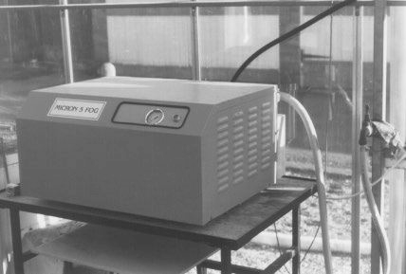
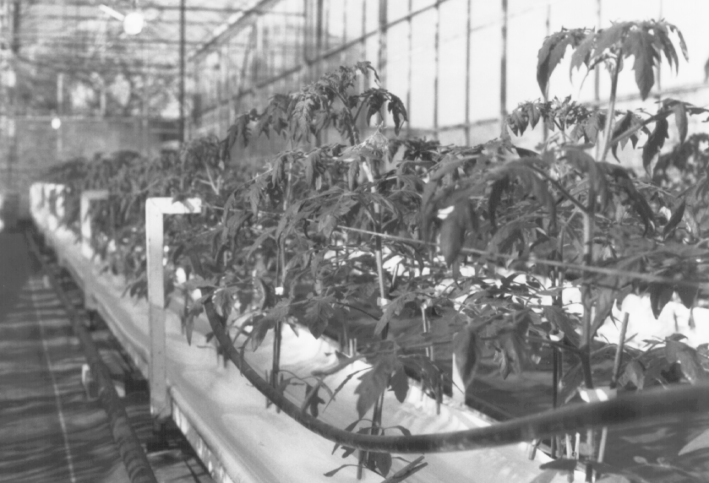
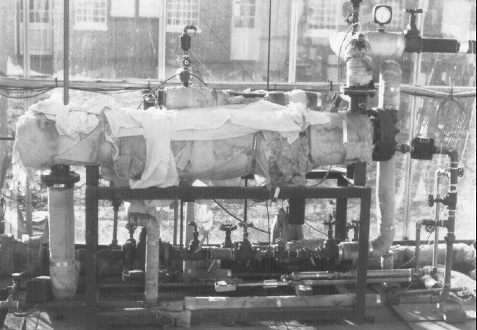
CO₂ supply pipe
Heating pipe
Glasshouse Actuators for Humidity, Temperature and Carbon Dioxide

Slide 7
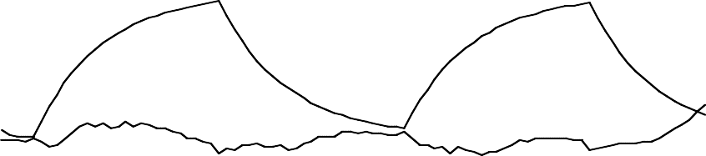
Greenhouse Data
and Illustrative Model
Valve position and air temperature
0.65z⁻²
y(k ) = u(k )
1− 0.91z⁻¹
10
5
0
⎛
⎜
0.65z⁻²
⎞
⎟
19:00 23:00 3:00 7:00
Air temperature, model fit and errors
y =
u
⎜
k
−1
k
⎟
10
⎝
1− 0.91z
⎠
5
0
19:00
23:00
Time
3:00
7:00

Slide 8
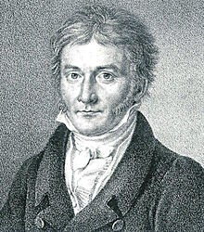
Least Squares
14
12
10
8
6
4
5 10 15 20
14
12
10
8
6
4
5 10 15 20
14
12
10
8
6
https://en.wikipedia.org
4
5
10
15
20

Slide 9
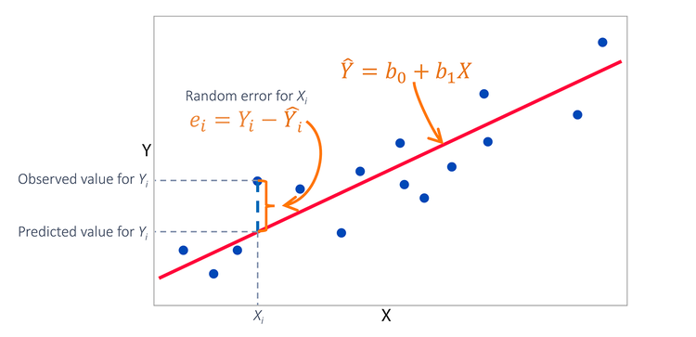
Least Squares

Slide 10
Least Squares
The Least Squares Method in control theory is a mathematical technique used to estimate the parameters of a linear dynamic system or model based on observed data.
This method is particularly useful when trying to identify or model a system's transfer function, which relates the system's input to its output.

Slide 11
Coming up…
Parameter Estimation using Least Squares
Response Error
Equation Error
(Prediction Error)
Notes:
When modelling a system you must first estimate the form of the transfer function (order, time delay etc.), and then estimate the parameters (coefficients for the transfer function).
A common way to estimate these parameters is to formulate a cost function describing the accuracy of the estimates, and then minimise this cost function with some numerical or analytical optimisation method. Two common forms of the cost function are the Equation Error and the Output Error.

Slide 12

Part 3 – System Identification
Contents
Section 3.1 – Least Squares
Section 3.2 – Response Error
Section 3.3 – Equation Error
Section 3.4 – Estimation Accuracy
Section 3.5 – Summary & Recap

Slide 13
Recap from Part 2
u_{k}
b₁z
−1
y_{k}
input
1+ a₁z
−1
output
mathematical model

Slide 14
General Discrete-Time TF Model
u_{k}
B(z⁻¹)
y_{k}
A(z⁻¹)
b₀ + b₁z
−1
+☹+ b_{m} z
−m
−1
₌ B(z ) _{u}
y =
u
k
−1 −2
−n
k
−1
k
1+ a₁z + a₂ z +☹+ a_{n}z
A(z )
How do we estimate the model coefficients?
How do we estimate n and m?
How do we estimate the time delay?

Slide 15
Response Error Block Diagram (1)
ξ_{k}
u_{k}
b₁z
−1
x_{k}
y_{k}
+
1+ a₁z
−1
e
system
±
k
_{b}ˆ _{z}−1
yˆ_{k}
1
1+ aˆ z⁻¹
1
model

Slide 16
Response Error Cost Function
_{b}ˆ _{z}−1
e = y − yˆ = y −
1
u
k k
k
k
1+ aˆ z⁻¹
k
1
N
N
J = ∑ e
J = ∑ e ²
k
k
k =1
k =1
We use Square?

Slide 17
Response Error Block Diagram (2)
ξ_{k}
u_{k}
b₁z
−1
x_{k}
y_{k}
+
1+ a₁z
−1
e_{k}
N
system
±
2
J = ∑ e_{k}
k =1
_{b}ˆ _{z}−1
yˆ_{k}
1
cost function
1+ aˆ z⁻¹
1
model
Least Squares estimation
adjust estimates (somehow)

Slide 18
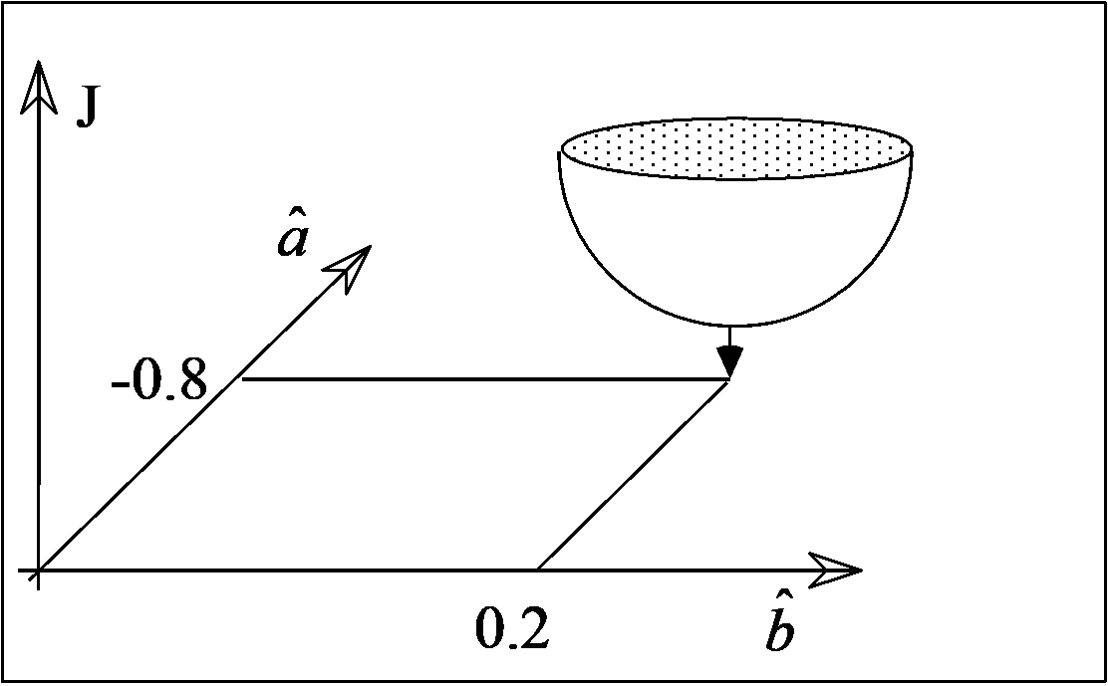
Numerical optimisation
Cannot be solved analytically, hence numerical optimisation required e.g. steepest descent
Requires initial conditions & may have multiple minima

Slide 19
MATLAB
Matlab Identification Toolbox – pem uses prediction-error minimization (partially analytic)
In-built Matlab function – fminsearch uses the Nelder- Mead simplex (direct search) method
Also, Genetic Algorithms, etc.

Slide 20
Response Error Block Diagram (Generalised)
ξ_{k}
u_{k}
B(z⁻¹)
x_{k}
y_{k}
+
A(z⁻¹)
system
B^{ˆ} (z⁻¹)
1.0
A^{ˆ} (z⁻¹)
yˆ_{k}
y_{k}
−+
B^{ˆ} (z⁻¹)
e_{k} = y_{k} − u_{k} A^{ˆ} (z⁻¹)

Slide 21
Response Error Method:
The Response Error Method focuses on minimizing the difference between the measured system response and the response predicted by the model.
Nonlinearity: The Response Error Method is primarily designed for linear models. It may not work well for highly nonlinear systems without linearizing them around operating points.
Initialization: The method often requires initial guesses for model parameters, which can be challenging to obtain accurately.

Slide 22
Part 3 – System Identification
Contents
Section 3.1 – Least Squares
Section 3.2 – Response Error
Section 3.3 – Equation Error
Section 3.4 – Estimation Accuracy
Section 3.5 – Summary & Recap

Slide 23
Equation Error
ξ_{k}
u_{k}
b₁z
−1
x_{k}
y_{k}
+
b₁z
−1
1+ a₁z⁻¹
x =
u
k
1+ a₁z
−1
k
^{x}k ^{+ a}1^{x}k −1 ^{= b}1^{u}k −1
( ^{y}k ^{− ξ}k ) ^{+ a}1 ( ^{y}k −1 ^{− ξ}k −1 ) ^{= b}1^{u}k −1
x_{k} = y_{k} − ξ_{k}
^{y}k ^{= −a}1 ^{y}k −1 ^{+ b}1^{u}k −1 ^{+ ξ}k ^{+ a}1^{ξ}k −1

η_{k}

Slide 24
Equation Error Continued
ξ_{k}
u_{k}
b₁z
−1
x_{k}
y_{k}
+
1+ a₁z
−1
^{y}k ^{= −a}1 ^{y}k −1 ^{+ b}1^{u}k −1 ^{+ ξ}k ^{+ a}1^{ξ}k −1

η_{k}
40
y = −aˆ y
b^{ˆ} u + E
30
k 1k −1 1 k −1
k
 
yˆ_{k}
20
10
0
E_{k} = y_{k} − yˆ_{k}
10 20 30 40
(
ˆ
)
)
RE:
^{yˆ}k ^{= −aˆ}1 ^{yˆ}k −1 ^{+ b}1^{u}k −1
E = y + aˆ y
b^{ˆ} u
(EE:
b^{ˆ} u
k
k
1
k −1
1 k −1
yˆ
= −aˆ y
k
1 k −1
1 k −1

Slide 25
Equation Error Cost Function
ξ_{k}
u_{k}
b₁z
−1
x_{k}
y_{k}
+
1+ a₁z
−1
N
∑
k =1
E² =
N
∑
{
b^{ˆ} u
}
2
J =
y + aˆ y
k
k
1 k −1
1 k −1
k =1
∂J
N
(
b^{ˆ} u
)
)
(
k −1 )
= 2 ∑ y
aˆ y
y
= 0
∂aˆ₁
∂J
k
1 k −1
1 k −1
k =1
N
(
b^{ˆ} u
(
k −1 )
= 2 ∑ y
aˆ y
−u
= 0
ˆ
k
1 k −1
1 k −1
∂b₁
k =1

Slide 26
Multiply out the brackets
ξ_{k}
u_{k}
b₁z
−1
x_{k}
y_{k}
+
1+ a₁z
−1
N N
∑ y y + ∑ aˆ y
N
y − ∑ b^{ˆ} u
y = 0
k k −1
1 k −1 k −1
1 k −1 k −1
k =1
k =1
k =1
N N
∑ y u − ∑ aˆ y
N
u + ∑ b^{ˆ} u u
= 0
k k −1
1 k −1 k −1
1 k −1 k −1
k =1
k =1
k =1

Slide 27
The Normal Equations
ξ_{k}
u_{k}
b₁z
−1
x_{k}
y_{k}
+
1+ a₁z
−1
N
∑ aˆ y y − ∑ b^{ˆ} u
N
N
y = − ∑ y y
1 k −1 k −1
1 k −1 k −1
k k −1
k =1
k =1
k =1
N
∑ aˆ y u + ∑ b^{ˆ} u u
N
N
= ∑ y u
1 k −1 k −1
1 k −1 k −1
k k −1
k =1
k =1
k =1

Slide 28
Equation Error Method:
The Equation Error Method focuses on minimizing the difference between the model's output and the actual measured output in the model's state-space representation.
Square error Problem

Slide 29
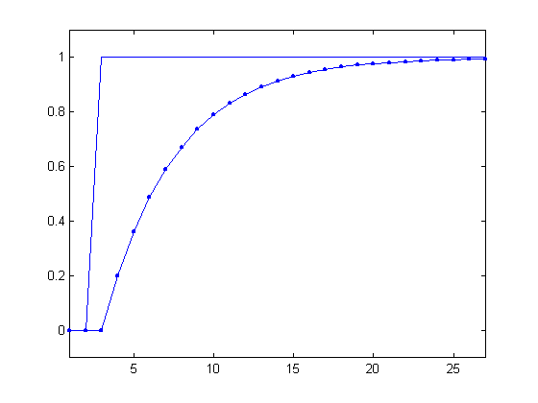
Reservoir Model Data
k | u(k ) | u(k −1) | y(k)
2 | 0 | 0 | 0
3 | 1 | 0 | 0
4 | 1 | 1 | 0.2
5 | 1 | 1 | 0.36
6 | 1 | 1 | 0.49
7 | 1 | 1 | 0.59

Slide 30
Reservoir Model Exercise
Calculate the model coefficients from the data above
These are simulated data, and the model coefficients are exactly known (see previous PPTs):
y(k) = 0.8 y(k −1) + 0.2u(k −1)
Hence this exercise is simply to demonstrate that the equation error method can give the ‘correct’ answer
Final answer is above, but you need to verify it:

Slide 31
Matlab functions
In-built functions (backslash: see later)
Specialist toolboxes
Identification Toolbox (The Mathworks) – arx
Captain Toolbox (Lancaster University) – riv (option)

Slide 32
Part 3 – System Identification
Contents
Section 3.1 – Least Squares
Section 3.2 – Response Error
Section 3.3 – Equation Error
Section 3.4 – Estimation Accuracy (Advanced Topic)
Section 3.5 – Summary & Recap

Slide 33
Real data with noise
Applied voltage
Airflow (m/s)
b₁z
−1
u_{k}
1+ a₁z
−1
y_{k}
10
8
6
4
2
0
y_{k}
u_{k}
0
10 20 30 40 50

Slide 34
Accuracy of the Parameter Estimates
Analysis above assumes ηk = ξk + a1ξk −1 is a zero mean, serially uncorrelated Gaussian sequence (white noise)
Otherwise the parameter estimates are biased away from their true values!
^{y}k ^{= −a}1 ^{y}k −1 ^{+ b}1^{u}k −1 ^{+ ξ}k ^{+ a}1^{ξ}k −1

η_{k}
ξ_{k}
u_{k}
b₁z
−1
x_{k}
y_{k}
+
1+ a₁z
−1

Slide 35
Special case
Unbiased if ηk = ξk + a1ξk −1
is a zero mean, serially
uncorrelated Gaussian sequence (white noise):
e_{k}
b₁z
−1
1
y =
u +
e
1
k
−1
k
−1
k
1+ a₁z 1+ a₁z
1+ a₁z
−1
AutoRegression with eXogeneous variables (ARX) model
ξ_{k}
u_{k}
b₁z
−1
x_{k}
y_{k}
+
1+ a₁z
−1

Slide 36
More realistic
Equation Error approach yields biased estimates of the parameters in the presence of general noise e.g.
e_{k}
b₁z
−1
1
y =
u +
e
1
k
−1
k
−1
k
1+ a₁z 1+ c₁z
1+ c₁z
−1
Box-Jenkins type of model with AutoRegressive (AR) noise
ξ_{k}
u_{k}
b₁z
−1
x_{k}
y_{k}
+
1+ a₁z
−1

Slide 37
Instrumental Variables
z^{T} = [− y
₁,😐, − y , u , u ₁,😐, u
]
T
k k −
k −n k k − k −m
y_{k} = z_{k} p + n_{k}
p = [a₁,😐, a_{n} , b₀ , b₁,😐, b_{m} ]
−1
⎞
⎛ N
N
∑ z_{k} y_{k}
k =1
ˆ
=
T
p
⎜
∑
z z
⎟
LS
k k
⎝ k =1
⎠
−1
⎞
⎛ N
N
^{∑ xˆ}k ^{y}k
k =1
^{pˆ} IV
=
∑
x
ˆ
z
T
⎜
k k
⎟
⎝ k =1
⎠

Slide 38
Instrumental Variables (Continued)
Eliminates the problem of parameter bias for the Equation Error method
Utilises ‘instrumental variables’ which are (i) correlated to the original variables and (ii) independent of noise
The response of an initial model obtained using standard equation error Least Squares estimation is used as the instrumental variables in the next iteration
e.g. RIV function in the CAPTAIN Toolbox

Slide 39
Part 3 – System Identification
Contents
Section 3.1 – Least Squares
Section 3.2 – Response Error
Section 3.3 – Equation Error
Section 3.4 – Estimation Accuracy
Section 3.5 – Summary & Recap
Section 3.6 – Identification

Slide 40
Equation Error (Generalised Form)
B(z⁻¹)
A(z⁻¹)
E_{k} = y_{k} + aˆ₁ y_{k −1}
b^{ˆ} u
1 k −1
(
1 ₎
(
1 ₎
E = 1+ aˆ z⁻
y − b^{ˆ} z⁻ u
k
1
k
1
k
(
) (
ˆ
z ¹ +😐+ b_{m} z )u_{k}
−
−n
−
ˆ
−m
E = 1+ a z ¹ +😐+ a_{n}z
ˆ
ˆ
y − b
k
1
k
1
E_{k} = A^{ˆ} (z⁻¹) y_{k} − B^{ˆ} (z⁻¹)u_{k}

Slide 41
Equation Error Block Diagram
ξ_{k}
u_{k}
B(z⁻¹)
x_{k}
y_{k}
+
A(z⁻¹)
system
B^{ˆ} (z⁻¹)
A^{ˆ} (z⁻¹)
−+
E_{k} = A^{ˆ} (z⁻¹) y_{k} − B^{ˆ} (z⁻¹)u_{k}

Slide 42
Equation Error Summary
B(z⁻¹)
1
Unbiased estimates for:
y_{k} = ₋₁ u_{k} + ₋₁ e_{k} A(z ) A(z )
Equation Error approach yields biased estimates in the presence of general noise, for example:
B(z⁻¹)
1
y_{k} = ₋₁ u_{k} + ₋₁ e_{k} A(z ) C(z )
Can be corrected in various ways, such as Extended Least Squares, Instrumental Variables, etc.

Slide 43
http://wp.lancs.ac.uk/captaintoolbox/
Captain Toolbox for MATLAB
riv/rivid – Least Squares (LS), Instrumental Variables (IV), Refined IV (RIV) and Simplified Refined IV (SRIV)
Estimates Box-Jenkins models, including AutoRegressive Moving Average (ARMA) noise filter
B(z⁻¹) D(z⁻¹) y_{k} = ₋₁ u_{k} + ₋₁ e_{k}
A(z ) C(z )
B (z⁻¹)
B_{p} (z⁻¹)
D(z⁻¹)
y
=
1
u
+😐+
u +
e
k
A(z⁻¹)
1,k
A(z⁻¹)
p,k
C(z⁻¹)
k

Slide 44
Comparison of
EE (left) and RE (right)
ξ_{k}
ξ_{k}
u_{k}
B(z⁻¹)
x_{k}
y_{k}
u_{k}
B(z⁻¹)
x
y_{k}
+
k
+
A(z⁻¹)
system
A(z⁻¹)
system
B^{ˆ} (z⁻¹)
B^{ˆ} (z⁻¹)
A^{ˆ} (z⁻¹)
1.0
ˆ
−1
A(z )
yˆ_{k}
y_{k}
−+
−+
B^{ˆ} (z⁻¹)
E_{k} = A^{ˆ} (z⁻¹) y_{k} − B^{ˆ} (z⁻¹)u_{k}
e_{k} = y_{k} − _{ˆ}
u_{k}
−1
A(z )
Notes:
It is said that the Output Error is better for noisy data but the equation error is better otherwise since it does not suffer the local minima problem.

Slide 45
Recap
Response Error yields unbiased estimates but must be solved using numerical methods (hence consider initial conditions, local minima, computation time, etc.)
Equation Error can be analytically solved but Least Squares estimation yields biased parameter estimates in the presence of noise
Unbiased estimates can be obtained using e.g. instrumental variables

Slide 46
Relationship between RE and EE
B^{ˆ} (z⁻¹)
e_{k} = y_{k} − u_{k} A^{ˆ} (z⁻¹)
e_{k} A^{ˆ} (z⁻¹) = A^{ˆ} (z⁻¹) y_{k} − B^{ˆ} (z⁻¹)u_{k} = E_{k}
1
e_{k} = E_{k}
A^{ˆ} (z⁻¹)

Slide 47

Matlab Example (with zero noise)
>> u =[zeros(10,
>> y = filter([0
>> plot([u y])
>>
>>
1); ones(90, 1)];
2], [1 -0.8], u);
% step input
% noise free output
% plot simulated data
% exogenous variables
% LS estimation
z = [-y(1:end-1) p = z \ y(2:end)
u(1:end-1)];
p =
-0.8000
10
8
6
2.0000
0
u_{k}
_{2z}−1
x_{k}
y_{k}
4
+
2
0
1− 0.8z⁻¹
20
40
60
80
100

Slide 48

Matlab Example (with noise)
>> u =[zeros(10, 1); ones(90, 1)];
% step input
>> | y | = filter([0 2], [1 -0.8], | u); | % | noise free output
>> | y | = y + randn(100, 1)*0.4; |  | % | add white noise
>> plot([u y])
>>
>>
% plot simulated data
% exogenous variables
z = [-y(1:end-1) p = z \ y(2:end)
u(1:end-1)];
10
8
6
4
2
% LS estimation
p =
-0.7658
2.4255
ξ_{k}
u_{k}
_{2z}−1
x_{k}
y_{k}
+
1− 0.8z⁻¹
0
20
40
60
80
100

Slide 49

Matlab Example (Monte Carlo)
LS
RIV
a₁ = −0.799
b₁ = 2.003
a₁ = −0.751
b₁ = 2.459
Average from 1000 simulations
10
8
6
4
ξ_{k}
u_{k}
_{2z}−1
x_{k}
y_{k}
+
1− 0.8z⁻¹
2
0
20
40
60
80
100

